Slide 1
Smart Sensory Furniture Based on WSN for Ambient Assisted Living
(IEEE SENSORS JOURNAL,SEPTEMBER 1, 2017)
DEEPIKA R
MANUSHREE L
VAIYAVI V
GUIDED BY MRS.ASHWINI

Slide 2
INTRODUCTION
SSF is an ambient assisted living
system that allows inferring a
potential dangerous action of an
elderly person living alone at
home.

Slide 3
OBJECTIVE
The basic idea behind the SSF project is that ,
by integrating networked sensors and actuators
in objects like furniture, a system can be built
providing supervision similar to a
caregiver.

Slide 4
PROPOSED SYSTEM
The elderly is taken care by giving an alert
to the care taker in case of emergency.
Also, if left alone during the mid night
and in case he / she tries to get
off the bed, an alert message is
passed over.

Slide 5
LITERATURE SURVEY
In “Wireless Sensor Network Based Home Monitoring System for Wellness Determination of Elderly”, Alert message communication to the respective care taker isn’t configured which limitation has been overthrown in proposed system.[1]
“Smart Health Monitoring Chair for Nonintrusive Measurement of Biological Signals” electrodes were used instead of conductive yarns [2]

Slide 6
CONTD…
“Wellness Sensor Networks: A Proposal and Implementation for Smart Home for Assisted Living”,Hemant Ghayvat suggested RF and IR usage.[3]
Adding on to it, PIR and Ultrasonic sensory division will provide a better confirmation of results .

Slide 7
SYSTEM DESIGN
In the proposed system, we have built an integrated sensory circuit that helps to monitor the wellbeing of the elderly people by using various sensors and communicating through GSM thus reporting to the care taker.

Slide 8

BLOCK DIAGRAM
ARDUINO
SENSOR NODES
GSM MODULE
USB
HARDWARE LAYER(FURNITURE)
BATTERY
MOBILE PHONE

Slide 9
FLOWCHART
Set up
sensor
Conductive yarn
ULTRASONIC
IR
PIR
IF CONDUCTS
IF INTERRUPTED
IF INTERRUPTED
IF INTERRUPTED
&&
ARDUINO RESPONSE
GSM
ALERT

Slide 10
LAYER SEPARATION
  The proposed system consists of three layers:
  HARDWARE LAYER
  SOFTWARE LAYER
  ANDROID APP LAYER

Slide 11
MODULES
ARDUINO PIN CONFIGURATION MODULE
SENSORY MODULE
ARDUINO IMPLEMENTATION MODULE
GSM MODULE

Slide 12
ARDUINO PIN CONFIGURATION MODULE
Assigning the output, input to the arduino TRIGPIN and ECHOPIN
Here we have configured pin 9 and pin 20 respectively.
Begin a serial communication by setting the rate to 9600 bits/second
Now , the data sent from the sensory nodes will be given as an input for processing through configured pins..

Slide 13
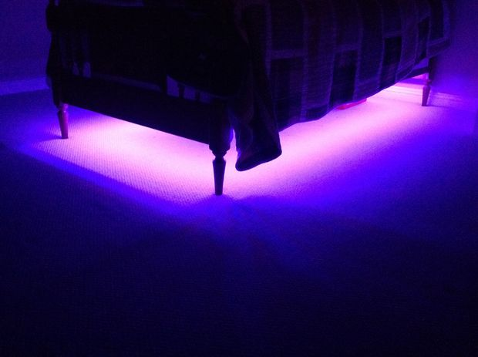

SMART BED

Slide 14
CONCLUSION
This system ensures safety measures for people in case of abnormal activities encountered while he stays alone or when everybody is asleep.
This system also consumes low power and is affordable

Slide 15
REFERENCE:
[1]Nagender Kumar Suryadevara and Subhas Chandra Mukhopadhyay.” Wireless Sensor Network Based Home Monitoring System for Wellness Determination of Elderly ” IEEE SENSORS JOURNAL, VOL. 12, NO. 6,Page number1965.
[2] Hyun Jae Baek, Gih Sung Chung, Ko Keun Kim, and Kwang Suk Park,“A Smart Health Monitoring Chair for Nonintrusive Measurement of Biological Signals” IEEE SENSORS JOURNAL, VOL. 15, NO. 12, DECEMBER 2015,Page no:1734.
[3]. Living Hemant Ghayvat,Jie Liu, Subhas Chandra Mukhopadhyay, and Xiang Gui “Wellness Sensor Networks: A Proposal and Implementation for Smart Home for Assisted” IEEE TRANSACTIONS ON INFORMATION TECHNOLOGY IN BIOMEDICINE, VOL. 16, NO. 1, JANUARY 2012 page number:150

Slide 16
THANKYOU

